Slide 1
MST and Max Flow
CS3233

Slide 2
Overview
Two Graph Problems
  Minimum Spanning Tree
  Maximum Flow/Minimum Cut Problem
One Data Structure
  Disjoint Sets

Slide 3
Minimum Spanning Tree
Prim’s and Kruskal’s Algorithm

Slide 4
Spanning Tree
Notes:
A spanning tree is a set of edges that connects every vertices but yet does not form a cycle. The minimum spanning tree problem (or MST) is the problem of finding a spanning tree where the total cost of the edges is minimum.

Slide 5
Minimum Spanning Tree
Given a graph G, find a spanning tree where total cost is minimum.

Slide 6
Prim’s Algorithm
3
2
1
4
1
3
3
4
2
4
2
3
1
3
4
4
5
1
4
3
Notes:
Prim’s algorithm is an example of greedy algorithm.
At every iteration, it chooses an edge with minimum cost that does not form a cycle.

Slide 7
Prim’s Algorithm
3
2
1
4
1
3
3
4
2
4
2
3
1
3
4
3
4
5
1
4
3

Slide 8
Prim’s Algorithm
3
2
1
4
1
3
3
4
2
4
2
3
1
3
4
3
4
5
1
4
3

Slide 9
Prim’s Algorithm
3
2
1
4
1
3
3
4
2
4
2
3
1
3
4
3
4
5
1
4
3

Slide 10
Prim’s Algorithm
3
2
1
4
1
3
3
4
2
4
2
3
1
3
4
3
4
5
1
4
3

Slide 11
Prim’s Algorithm
3
2
1
4
1
3
3
4
2
4
2
3
1
3
4
3
4
5
1
4
3

Slide 12
Prim’s Algorithm
3
2
1
4
1
3
3
4
2
4
2
3
1
3
4
3
4
5
1
4
3

Slide 13
Prim’s Algorithm
3
2
1
4
1
3
3
4
2
4
2
3
1
3
4
3
4
5
1
4
3

Slide 14
Prim’s Algorithm
3
2
1
4
1
3
3
4
2
4
2
3
1
3
4
3
4
5
1
4
3

Slide 15
Prim’s Algorithm
3
2
1
4
1
3
3
4
2
4
2
3
1
3
4
3
4
5
1
4
3

Slide 16
Prim’s Algorithm
3
2
1
4
1
3
3
4
2
4
2
3
1
3
4
3
4
5
1
4
3

Slide 17
Prim’s Algorithm
3
2
1
4
1
3
3
4
2
4
2
3
1
3
4
3
4
5
1
4
3

Slide 18
Prim’s Algorithm
2
1
1
3
3
2
2
1
4
1
3

Slide 19
Prim’s Greedy Algorithm
color all vertices yellow
color the root red
while there are yellow vertices
pick an edge (u,v) such that
u is red, v is yellow & cost(u,v) is min
color v red
Notes:
Note: we can pick any node to be the root.

Slide 20
Why Greedy Works?
3
2
1
4
1
3
3
4
2
4
2
3
1
3
4
3
4
5
1
4
3

Slide 21
Why Greedy Works?
3
2
1
4
1
3
3
4
2
4
2
3
1
3
4
3
4
5
1
4
3

Slide 22
Why Greedy Works?
3
4
3
3
1
3
4
3
5
Notes:
Greedy works in this case, because any spanning tree must include one of the edge that connects the yellow and the red vertices. The edge with minimum cost must be part of the minimum spanning tree.

Slide 23
Prim’s Algorithm
foreach vertex v
v.key = ∞
root.key = 0
pq = new PriorityQueue(V)
while pq is not empty
v = pq.deleteMin()
foreach u in adj(v)
if v is in pq and cost(v,u) < u.key
pq.decreaseKey(u, cost(v,u))
Notes:
We can implement Prim’s algorithm using a priority queue, achieving the running time of O((V+E)log V). Yellow vertices are in priority queue. They becomes red once they are deleted.

Slide 24
Complexity: O((V+E)log V)
foreach vertex v
v.key = ∞
root.key = 0
pq = new PriorityQueue(V)
while pq is not empty
v = pq.deleteMin()
foreach u in adj(v)
if v is in pq and cost(v,u) < u.key
pq.decreaseKey(u, cost(v,u))

Slide 25
Kruskal’s Algorithm
3
2
1
4
1
3
3
4
2
4
2
3
1
3
4
3
4
5
1
4
3
Notes:
Another algorithm for MST is Kruskal. Kruskal’s algorithm is also greedy – it repeatedly finds edges with minimum costs that does not form a cycle. Note that Prim’s algorithm “grows” a MST from a root. Kruskal’s algorithm forms a MST by connected forests.

Slide 26
Kruskal’s Algorithm
3
2
1
4
1
3
3
4
2
4
2
3
1
3
4
3
4
5
1
4
3

Slide 27
Kruskal’s Algorithm
3
2
1
4
1
3
3
4
2
4
2
3
1
3
4
3
4
5
1
4
3

Slide 28
Kruskal’s Algorithm
3
2
1
4
1
3
3
4
2
4
2
3
1
3
4
3
4
5
1
4
3

Slide 29
Kruskal’s Algorithm
3
2
1
4
1
3
3
4
2
4
2
3
1
3
4
3
4
5
1
4
3

Slide 30
Kruskal’s Algorithm
3
2
1
4
1
3
3
4
2
4
2
3
1
3
4
3
4
5
1
4
3

Slide 31
Kruskal’s Algorithm
3
2
1
4
1
3
3
4
2
4
2
3
1
3
4
3
4
5
1
4
3

Slide 32
Kruskal’s Algorithm
3
2
1
4
1
3
3
4
2
4
2
3
1
3
4
3
4
5
1
4
3

Slide 33
Kruskal’s Algorithm
3
2
1
3
1
2
2
1
4
1
3

Slide 34
Kruskal’s Algorithm
while there are unprocessed edges left
pick an edge e with minimum cost
if adding e to MST does not form a cycle
add e to MST
else
throw e away

Slide 35
Data Structures
How to pick edge with minimum cost?
  Use a Priority Queue
How to check if adding an edge can form a cycle?
  Use a Disjoint Set

Slide 36
Disjoint Set Data Structure
Union/Find

Slide 37
Overview

Slide 38
Operation Union

Slide 39
Operation Find
A
B
C

Slide 40
Application: Kruskal’s
Initialize: Every vertex is one partition
while there are unprocessed edges left
pick edge e = (u,v) with minimum cost
// if adding e to MST does not form a cycle
if find(u) != find(v)
add e to MST
union(u, v)
else
throw e away

Slide 41
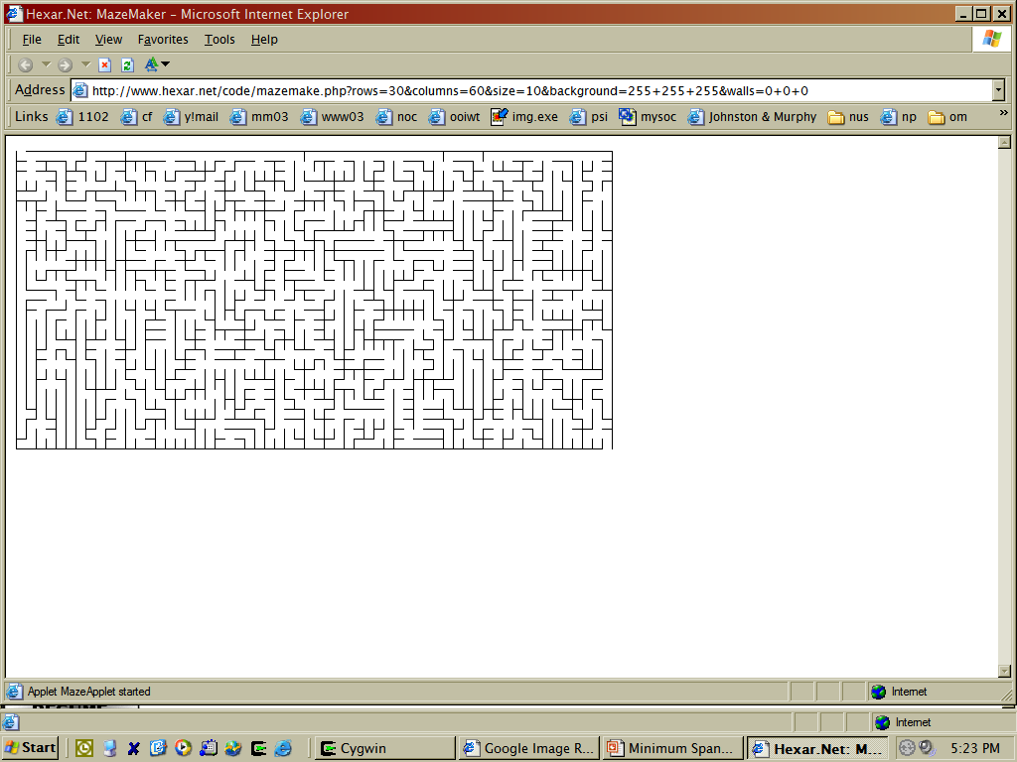
Application: Maze Generation

Slide 42
Algorithm
Starts with walls everywhere
Randomly pick two adjacent cells
Knock down the wall if they are not already connected
Repeat until every cell is connected

Slide 43
GenerateMaze(m,n)
toKnock = mn-1
while toKnock != 0
pick two adjacent cells u and v
if find(u) != find(v)
knock down wall between u and v
union(u,v)
toKnock = toKnock - 1

Slide 44
How to implement?
typedef struct item {
struct item *parent;
int data;
} item;
A
B
C
D

Slide 45
Union(A, B)
B
A
C
D

Slide 46
Union(A, C)
C
B
A
D

Slide 47
Union(D, B)
C
B
A
D

Slide 48
Union(A, B)
// find root of A
// set parent of root of A to B
curr = A
while (curr.parent != NULL)
curr = curr.parent
curr.parent = B

Slide 49
Find(A)
// return root of A
curr = A
while curr.parent != NULL
curr = curr.parent
return curr

Slide 50
How to make find faster?
Reduce the length of path to root!
  union-by-rank
  path compression

Slide 51
Union by Rank (A, B)
rootA = root of A
rootB = root of B
if tree of rootA is shorter
rootA.parent = rootB
else
rootB.parent = rootA

Slide 52
find(A) with Path Compression
if A.parent != NULL
A.parent = find(A.parent)
return A.parent
else
return A

Slide 53
Path Compression
Before
After

Slide 54
Review
Minimum Spanning Tree
Prim’s and Kruskal’s Algorithm
Union-Find Data Structure

Slide 55
Variations
Does Prim and Kruskal works with negative weights?
How about Maximum Spanning Tree?

Slide 56
Max Flow/Min Cut

Slide 57
Problem

Slide 58
Definitions
Capacity
7
Source
Sink

Slide 59
A Flow
3
5
7
2

Slide 60
A Cut

Slide 61
Capacity/Flow Across A Cut

Slide 62
Problem
Find a cut with minimum capacity
Find maximum flow from source to sink

Slide 63
More Definition: Residual Graph
3
5
7
2
5
2

Slide 64
Augmenting Path
A path from source to sink in the residual graph of a given flow

Slide 65
Idea
If there is an augmenting path in the residual graph, we can push more flow

Slide 66
Ford-Fulkerson Method
initialize total flow to 0
residual graph G’= G
while augmenting path exist in G’
pick a augmenting path P in G’
m = bottleneck capacity of P
add m to total flow
push flow of m along P
update G’

Slide 67
Example
2
3
1
3
3
1
1
1
3
1
1
4
3
2
2
1
1
1
2
4
4
2

Slide 68
Example
2
3
1
3
3
1
1
1
3
1
1
4
3
2
2
1
1
1
2
4
4
2

Slide 69
Example
2
3
1
3
3
1
1
1
3
1
1
4
3
2
2
1
1
1
2
3
3
1
1
1
1

Slide 70
Example
2
3
1
3
3
1
1
1
3
1
1
4
3
2
2
1
1
1
2
3
3
1
1
1
1

Slide 71
Example
2
1
1
1
3
1
1
1
1
1
1
4
3
2
2
1
1
1
2
3
3
1
1
1
1

Slide 72
Example
2
1
1
1
3
1
1
1
1
1
1
4
3
2
2
1
1
1
2
3
3
1
1
1
1

Slide 73
Example
2
1
1
1
3
1
1
1
1
1
1
3
3
1
2
1
1
1
2
2
2
2
2
2

Slide 74
Answer: Max Flow = 4
2
2
2
2
2
1
1
1
2
2
2

Slide 75
Answer: Minimum Cut = 4
2
3
1
3
3
1
1
1
3
1
1
4
3
2
2
1
1
1
2
4
4
2

Slide 76
Find Augmenting Path?
initialize total flow to 0
residual graph G’= G
while augmenting path exist in G’
pick a augmenting path P in G’
m = bottleneck capacity of P
add m to total flow
push flow of m along P
update G’

Slide 77
Picking Augmenting Path
Edmonds-Karp’s Heuristics
  Find a path with maximum bottleneck capacity
  Find a path with minimum length

Slide 78
Variations
How about Maximum Cut?

Slide 79
Applications for MaxFlow/MinCut

Slide 80
Application: Bipartite Matching
Marriage Problem
BTW, how to determine if a graph is bipartite?

Slide 81
A Matching

Slide 82
Maximum Matching

Slide 83
Maximum Flow Problem

Slide 84
Maximum Flow/Matching

Slide 85
Minimum Vertex Cover Bipartite Graph
5
2
1
2
4
3
2
3
4
2

Slide 86
A Vertex Cover (W=15)
5
2
1
2
4
3
2
3
4
2

Slide 87
Maximum Flow
5
2
1
2
4
3
2
3
4
2

Slide 88
Finite Cut = Vertex Cover
5
2
1
2
4
3
2
3
4
2

Slide 89
Finite Cut = Vertex Cover

Slide 90
Problems..

Slide 91
Problem 1: Optimal Protein Sequence
Given a 2D geometric structure of a protein, with n residuals

Slide 92
Optimal Protein Sequence
Each residual can be either hydrophobic (H) or polar (P)

Slide 93
Optimal Sequence
Each residual has a “solvent area”
Want to reduce solvent areas of Hs
Want to increase pairs of Hs in close contacts

Slide 94
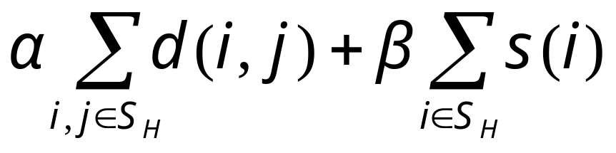
Optimal Sequence
Assign H, P to the residuals to minimize
d(i,j): 1 if H at position i and H at position j is close enough, 0 otherwise
s(i) : area exposed at position i

Slide 95
Problem 2: Forest Clearence
cannot clear
two adjacent
square!
5
10
profit for
cutting trees
8
12
which squares to clear to maximize profit?

Slide 96
Problem 3: All-Pair Maximum Bottleneck Bandwidth Path
Given a graph, how to find the maximum bottleneck bandwidth path between any two nodes, u and v, efficiently?

